Slide 1
GSM Interception

Slide 2
Introduction
Global System for Mobile communication (GSM) is a globally accepted standard for digital cellular communication
It is the most widely used cellular mobile phone system in the world with over 100 million GSM subscribers.
GSM was one of the first digital mobile phone systems to follow the analog era.
Problem with GSM's analog counter parts: intercepting the phone call over the air and eavesdropping on the discussion.

Slide 3
The GSM Network
A generic GSM network consists of 3 main components:
Mobile Station
Base Station Subsytem
Network Subsytem

Slide 4
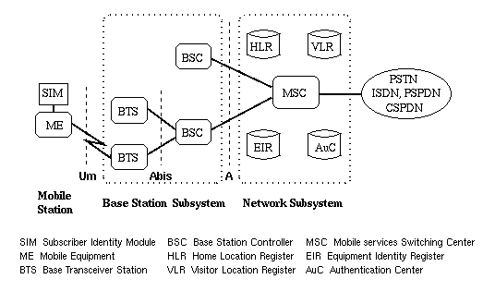
Architecture of the GSM Network

Slide 5
Definitions
A3 | The authentication algorithm used in the GSM system. Currently the COMP128 algorithm is used as the A3/A8 implementation in most GSM networks
A5 | The encryption algorithm used in the GSM system. There are various implementations named A5/1, A5/2, ... The A5/1 is known as the strong over-the-air voice-privacy algorithm. A5/x (A5/2 ...) are weaker implementations targeted at foreign markets out side of Europe. There is also an A5/0 algorithm, which encloses no encryption at all.
A8 | The key generation algorithm used in the GSM system. Currently COMP128 algorithm is used as the A3/A8 implementation in most GSM

Slide 6
GSM Security Model
The GSM Security Model is based on a shared secret between the subscriber's home network's HLR and the subscriber's SIM.
Purpose Of GSM Security:
Secure end-to-end channel for confidential data
Potential embarrassment, where customers may move to another service because of the lack of security.
Strong authentication i.e to protect the operator against billing fraud

Slide 7
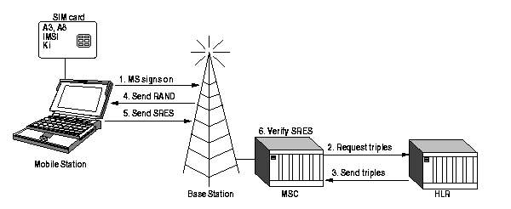
Mobile Station Authentication

Slide 8
Authentication
Authentication involves two functional entities:
  the SIM card in the mobile
  the Authentication Center (AuC).
Each GSM terminal is identified by a unique International Mobile Equipment Identity (IMEI) number.
A list of IMEIs in the network is stored in the Equipment Identity Register (EIR).
The status returned in response to an IMEI query to the EIR is one of the following:
  White-listed
  Grey-listed
  Black-listed

Slide 9
Authentication Algorithms
A3:The Ms Authentication Algorithm
A8:The Voice-Privacy Key Generation Algorithm
A5/1: The Strong Over-the-Air Voice –Privacy Algorithm.

Slide 10
Possible Interception Attacks
Brute-Force Attack against A5
Divide and Conquer Attack against A5
Accessing the signalling network
Retrieving the key from the SIM.
Retrieving the key from the SIM over the air
Retrieving the key from the AuC
Cracking the A8 Algorithm

Slide 11
GPRS Security Vs GSM Security
In GPRS, the SGSN handles the procedures where as in GSM it is handled by MSC.
The scope of GPRS is from the SGSN to the MSC where as in GSM it is from BTS and MS.
The GPRS system uses a new ciphering A5 algorithm which is different from GSM.

Slide 12
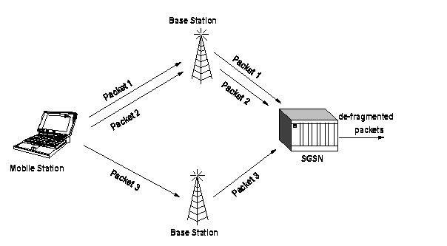
GPRS Architecture

Slide 13
Possible Improvements
Another cryptographically secure algorithm for A3 could be used.
To employ a new A5 implementation with strong encryption so that a brute-force attack is not feasible in any case.
To encrypt the traffic on the operators backbone network between the network components which would disable the attacker from wiretapping the backbone network

Slide 14
Conclusion
The secretly designed security algorithms in the GSM system have been proven faulty.
The GSM standard failed to correct the problems of phone fraud and call interception found in the analog mobile phone systems by using strong crypto for MS authentication and over-the-air traffic encryptiont.
The current GSM standard implements both subscriber identity cloning and call interception.

Slide 15
Thank You!!!

